Slide 1
Tableau to Snowflake
AI-Powered Analytics Platform Modernization Accelerator
[ Tableau → Streamlit in Snowflake ]
Streamlit in Snowflake | Cortex AI | Cortex Analyst | Native Semantic Views | Snowpark
Notes:
One-line framing: this modernizes the analytics stack in place — the customer's existing Tableau dashboards, rebuilt natively on the platform that already holds the data. The product strip at the bottom is the only place the full stack is listed; the rest of the deck stays light.

Slide 2
Why This Accelerator
Modernize the analytics stack — the same dashboards, running natively on the data Snowflake already holds
THE CHALLENGE
THE ACCELERATOR SOLUTION
Licences on Top of Snowflake
Dashboards Move to What You Own
Paying a second platform to display data Snowflake already holds
Streamlit is already part of Snowflake — no BI licence underneath
A Separate, Scarce Skill
Your Data Team Owns It
Every dashboard waits on Tableau specialists
Streamlit is Python — built by the engineers already on the platform
Two Platforms, Two Governance Models
One Platform, One Set of Roles
Access rules rebuilt away from the data they protect
Governance inherited from Snowflake, not re-implemented
Modernisation here removes a layer instead of adding one — the barrier was only ever the cost of rebuilding the dashboards by hand, and that is what the accelerator automates.
Notes:
Kept to one line per cell, per the feedback. The subtitle is the modernization framing: the stack is modernized in place — same dashboards, native on the platform that already holds the data. If asked what changes for end users: the dashboards look and answer the same; what disappears is the licence, the specialist queue, and the second governance model.

Slide 3
How It Works
Five automated stages inside the customer's Snowflake account — with a human gate before anything ships
01
02
03
04
05
Discovery
Parsing
Cortex Translation
Semantic + App
Validation
Finds every datasource and loads the data into Snowflake
Reads charts, calculations, filters and layout from the workbook
Cortex AI converts the complex calculations into Snowflake SQL
Deploys a native semantic view and generates the Streamlit app
Ties every measure back to the source, with evidence
Human in the Loop
Every Cortex proposal is executed against the real data, then reviewed and approved before it ships. All decisions audited.
Notes:
Five stages, one line each — the human gate is the only other element on the slide, framed as an enterprise control. Impact has its own slide later; nothing here repeats it.

Slide 4
Impact
Faster time to value — and a migration the business can trust
90%+
Minutes
100%
Day 0
Converted automatically
From workbook to live app
Of measures validated
Assessment first
No developer rebuild
Not sprints and handoffs
With downloadable evidence
Know what converts before committing
VALUE TO THE BUSINESS
VALUE TO SNOWFLAKE
Dashboards live in days, not development cycles
Warehouse compute on every view — extracts sent none
Owned by the data team — no specialist queue, no second platform
Cortex consumption on every workbook migrated
Gaps surfaced up front, never discovered late
BI workload consolidated onto the platform
Notes:
Restored as its own slide, in the crisp form: four big numbers with five-word sublines, then three one-line bullets per column. 90%+ is the design target the corpus exceeds; minutes is the real hosted-app runtime; 100% of measures is the Stage 5 parity check (13/13 on the demo run); Day-0 assessment is report.py. Left column wins the account; right column is why Snowflake cares.

Slide 5
Built Natively on Snowflake
The pipeline runs inside the customer's account, powered by Snowflake Cortex AI
1
2
3
Runs entirely in the account
Powered by Cortex AI
A semantic model falls out
Every stage executes on Snowflake compute; no data leaves the environment.
In-account Claude models translate the hard calculations and validate the result.
Each workbook's verified measures become a native semantic view, ready for Cortex Analyst.
4
5
6
Governance stays in force
No data movement
You own the result
The app runs as a Snowflake role — existing policies and security apply unchanged.
Dashboards read Snowflake tables directly — no extract, no copy, no staleness.
Generated apps, views and evidence live in the customer's account, maintainable by their team.
Every migrated dashboard converts a Tableau extract into live Snowflake consumption — warehouse compute on every view, Cortex on every migration.
Notes:
This slide absorbs the old What-Cortex-Does and value columns — six cards, one line each. The closing italic line is the consumption point for this audience: an extract-served dashboard sends Snowflake no query workload at all; migrated, every view is warehouse compute.

Slide 6
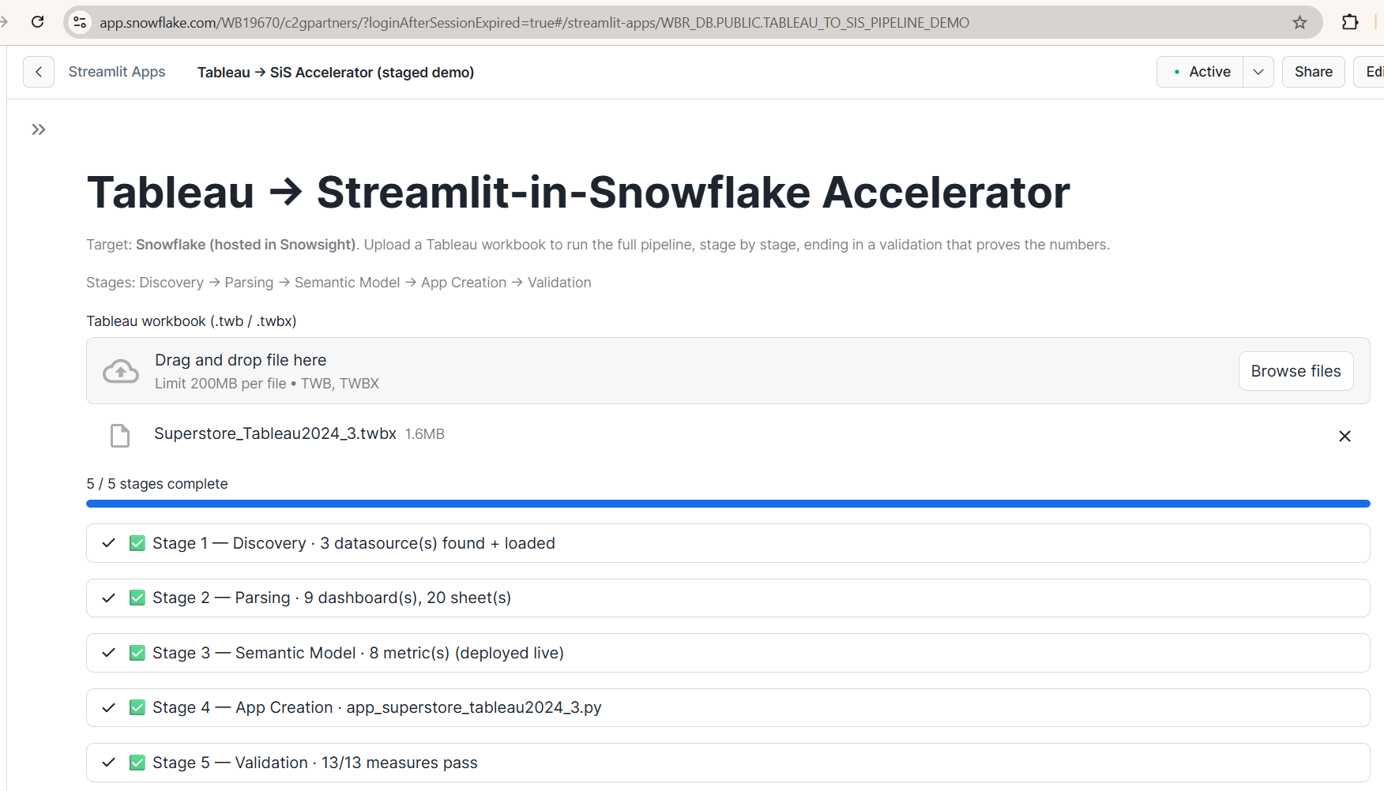
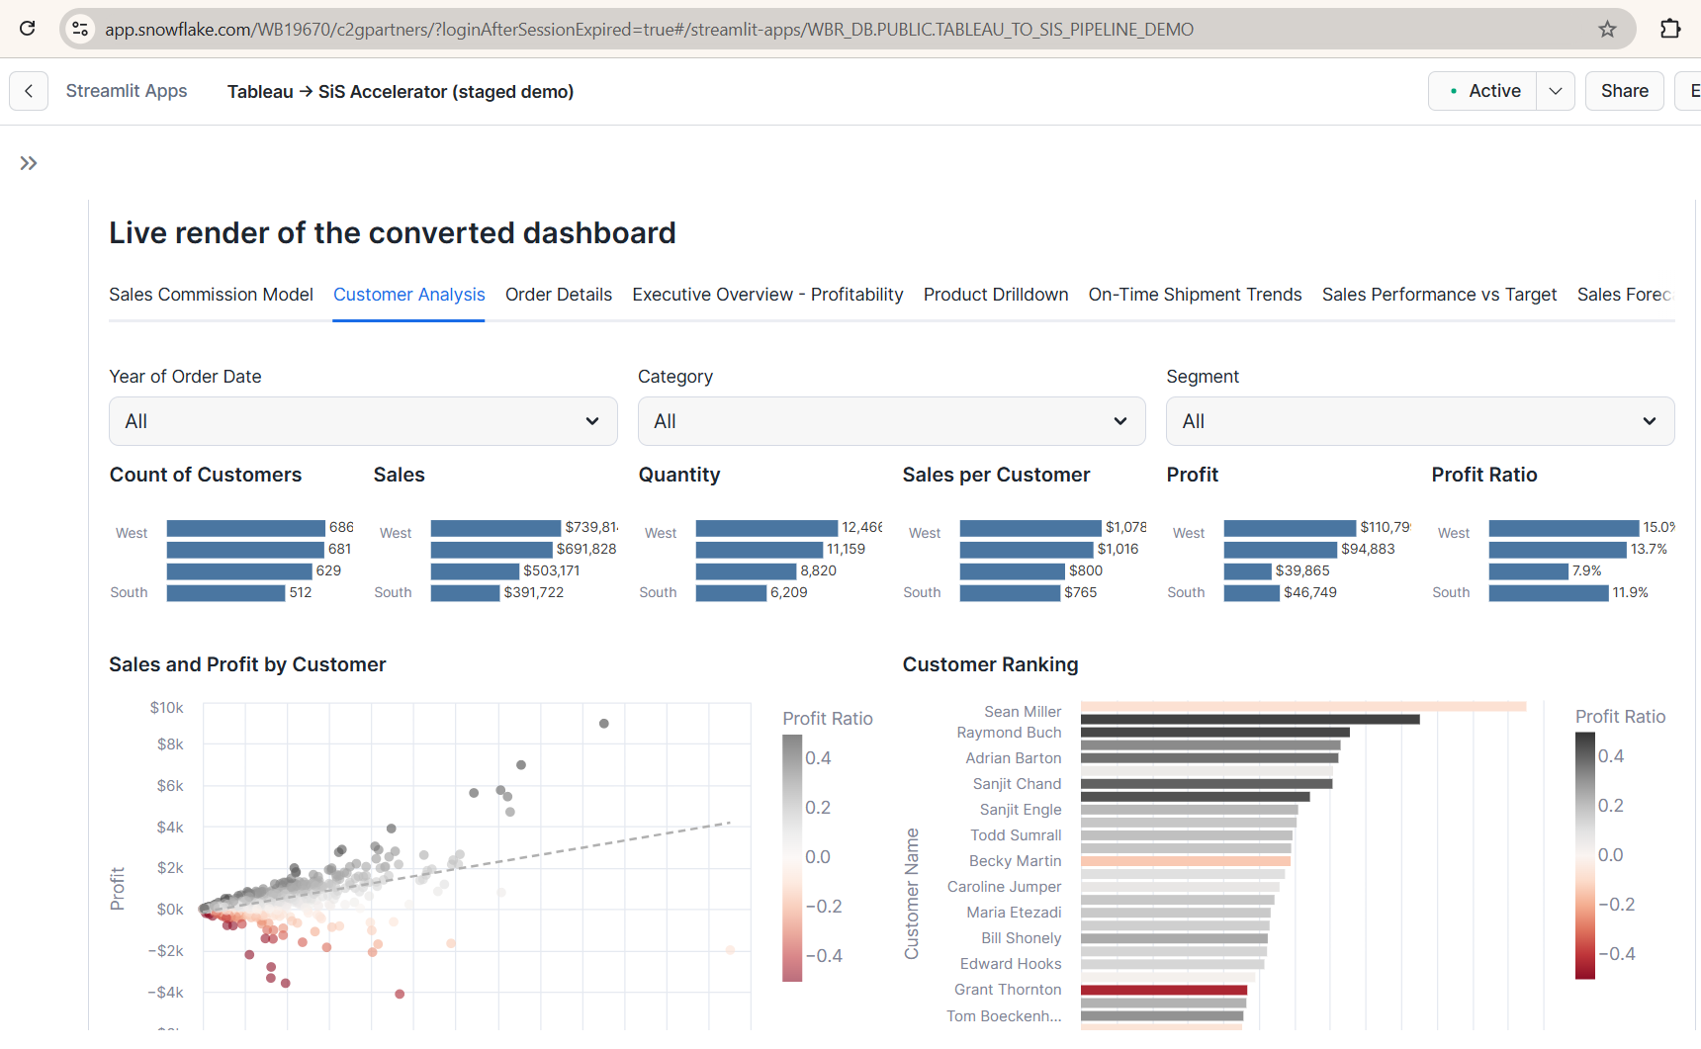
Running in Snowsight Today
One Tableau workbook, migrated end to end — hosted and executing inside Snowflake
The pipeline — five stages, executed in the account
The result — the converted dashboard, rendered natively
Superstore workbook · 3 datasources loaded · 20 sheets across 9 dashboards · 8 metrics deployed live · 13/13 measures pass.
Nine dashboard tabs with their filters, KPIs and charts — reading live from Snowflake tables.
Every statement is visible in Snowsight Query History with live timestamps.
Notes:
Real screenshots from the hosted app — the Snowsight URL and chrome are visible in both. Land on the left first: nine dashboards, twenty sheets, one run, thirteen of thirteen measures tying out. Offer to run it live; open Query History alongside if anyone questions where it is executing.

Slide 7
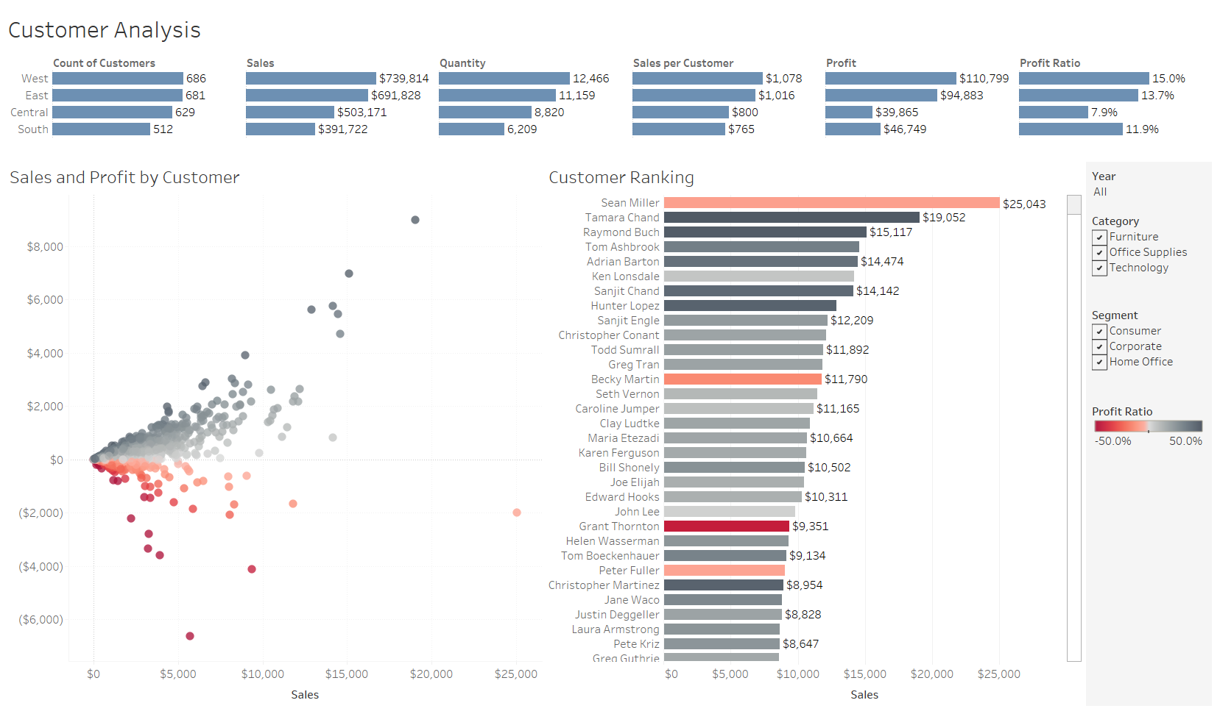
Tableau vs. Streamlit in Snowflake
The same dashboard, side by side
TABLEAU
STREAMLIT IN SNOWFLAKE
Same filters, same KPIs, same numbers — validated measure by measure at migration time.
Notes:
Mirrors the Tableau-vs-Power-BI comparison slide from the reference deck. Both sides show the SAME dashboard — Superstore Customer Analysis — and the numbers match cell for cell: West 686 customers, Sales $739,814, Sean Miller top-ranked at $25,043. Let the images do the talking; the one-line caption is the only claim on the slide.

